Slide 1
MERN LIVE CHAT APP “SNAPPY”
Presented by Wael Karaa

Slide 2
INTRODUCTION
The chatting application has huge impact on day to day life. There are numerous chatting application available in this world. Each application has different additional features varying from other applications. These application organizations compete with each other and add some competing features during each release. They have reached people much and have an impact on people’s life. People find a better application from an available internet application which they feel much reliable and secure. Some of the available chatting applications that are available in these days are Whatsapp, Facebook, Instagram, Hike, etc...The above mentioned applications have billion users all over the world. Those companies are one of the top companies in the world. They have higher revenue per year and have many employees for their organizations developing additional features to compete with other organizations during their each release. These applications have different features and follows different ways to ensure security of their user data. Today a data theft is the major crime and most people are involved in it. There are many cases being filed these days about personal data loss. So the organizations have to ensure the security from data loss by the third party data crisis. The basic chatting system should involve both sending and receiving processes simultaneously.In this application both sending and receiving messages simultaneously happens through MERN concept.

Slide 3
TECHNOLOGY USED
HTML, CSS and Javascript
1. Mongo DB: Cross-platform Document-Oriented Database
2. Express: Back-End Framework
3. React: Front-End Library
4. Node.js: JS Runtime Environment

Slide 4
Objective
My goal is to build a web chat that holds a single chat room. Any user can connect to it from an open window/tab, is able to upload an image to use as avatar during the chat, each connected user will see instantly any message sent, and new connected users will see the last 10 messages sent.Mongo DB makes use of records which are made up of documents that contain a data structure composed of field and value pairs. Documents are the basic unit of data in Mongo DB.Express does is that it enables you to easily create web applications by providing a slightly simpler interface for creating your request endpoints, handling cookies, etc. than vanilla Node.React is an open-source, component-based JavaScript library used to create quick and interactive interfaces or UI components for users for web and mobile-based applications. It is a declarative and highly accurate library that provides reusable code, which enhances the efficiency and flexibility of single-page applications.Node.js is an open-source and cross-platform JavaScript runtime environment. Node.js with Express.js can also be used to create classic web applications on the server-side.

Slide 5
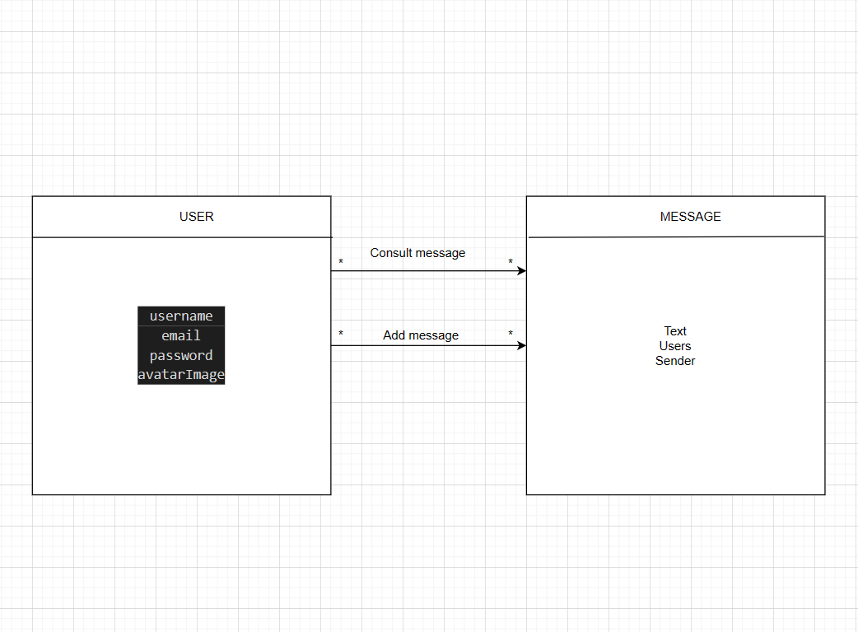
DIAGRAMMES

Slide 6
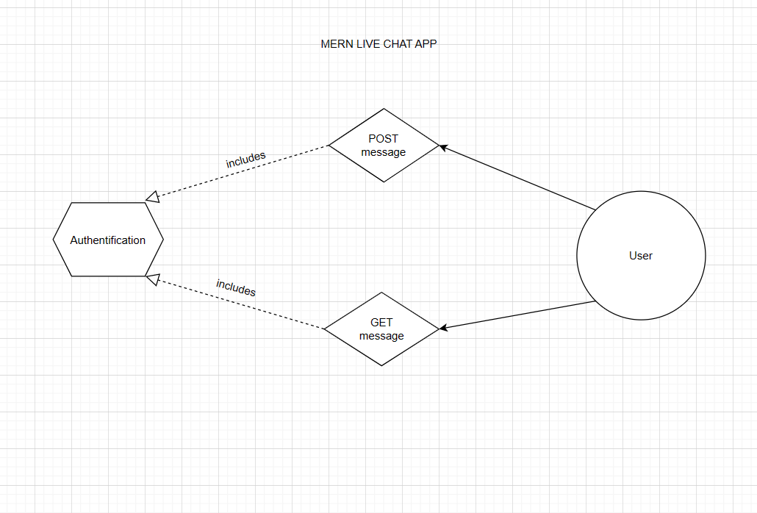
DIAGRAMMES

Slide 7
Conclusion
As a conclusion, I can say that this undergoing project is giving great experience. Thanks to this project, I am acquiring deeper knowledge concerning my technical skills but I also personally benefited. Currently MERN stack is a common technologies of web applications and chat applications, and one of the most popular technology for development used by developers worldwide

